Slide 1

IP Location Information Retrieval
Muhammad Abdullah(1823-2021)
Muhammad Hassaan(1761-2021)

Slide 2
OBJECTIVE:
The Bash script is developed to gather and present geolocation information for a specified IP address by leveraging the ip-api.com JSON API. The script is designed for command-line execution, offering a convenient way to retrieve and display location details for a given IP address.

Slide 3
Key Features:
Input Validation:
The script checks for the presence of a valid IP address as a command-line argument.
Provides a usage message and exits with an error code if no IP address is supplied.
Data Retrieval:
Utilizes the curl command to fetch JSON data from the ip-api.com API based on the provided IP address.
The obtained JSON response is stored in the variable res.

Slide 4
Key Features:
Status Verification:
Extracts the 'status' field from the JSON response using jq.
If the status is "success," proceeds with extracting and displaying location information.

Slide 5
Key Features:
Location Information Display (Success Case):
Parses and displays various location details:
City
Region
Country
Country Code
ZIP Code
Timezone
Latitude
Longitude
Organization
ISP (Internet Service Provider)
Queried IP address

Slide 6
Key Features:
Failure Handling (Failure Case):
In case the status is not "success," the script prints an error message.
Communicates the failure to retrieve location information for the specified IP address.

Slide 7
Tools Utilized:
cURL:
Employed for making HTTP requests and fetching data from the ip-api.com API.
JSON (JavaScript Object Notation):
The response data is structured in JSON format, facilitating easy extraction of relevant details.
jq:
Used for parsing and extracting specific fields from the JSON response, enhancing data manipulation capabilities.

Slide 8
Execution:
The script is executed from the command line, requiring an IP address as a parameter (e.g., ./script.sh 192.168.0.1).

Slide 9
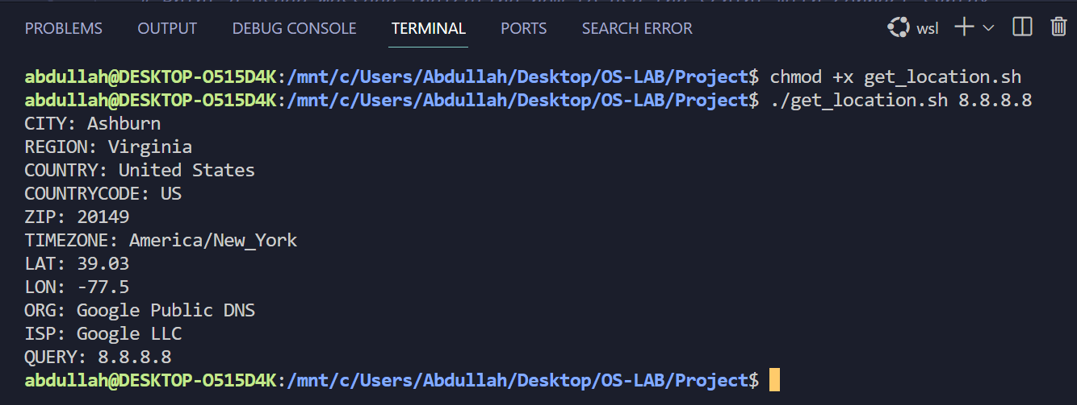
Execution:
Details of 8.8.8.8 IP Address

Slide 10
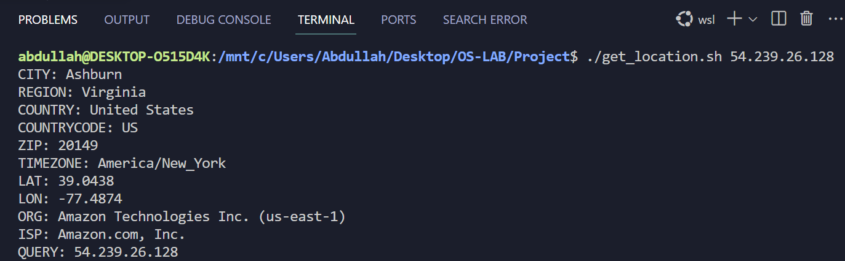
Execution:
Details of 54.239.26.128 IP Address

Slide 11
Outcome:
If successful, the script provides a comprehensive display of location information for the specified IP address.
In the event of a failure to retrieve information, an error message is presented to the user.

Slide 12
Usage:
./script.sh IP_ADDRESS

Slide 13
Conclusion:
The script offers a straightforward and efficient way to obtain and present location details for a given IP address. It harnesses commonly used command-line tools, making it accessible and user-friendly for individuals seeking quick geolocation information retrieval.

